Slide 1
Week 12: Introduction to Computer Vision-Based Deep Learning and Image Classification
Tuesday, March 28th, 2023

Slide 2
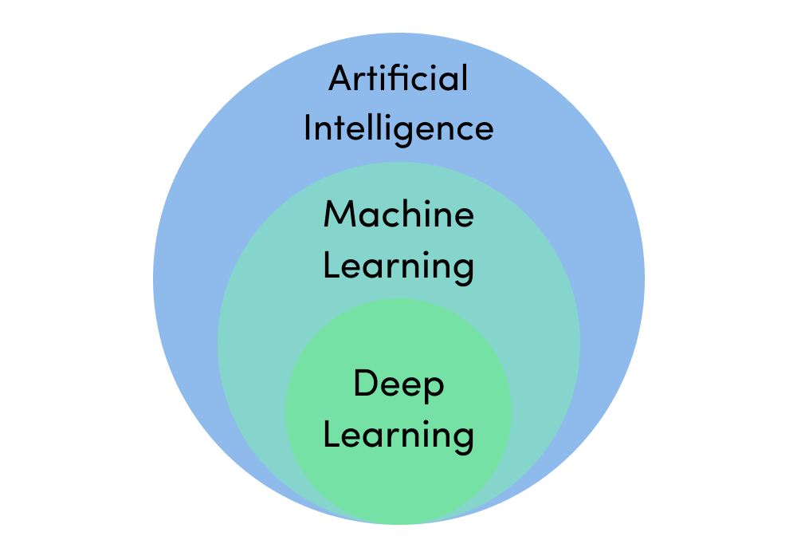
Deep Learning
Introduction
Deep learning is a technique of machine learning and artificial intelligence
Uses artificial neurons that learn information for identification
Models can be trained from scratch by creating custom neural networks
Existing models trained on another task can be finetuned for different tasks (Transfer Learning)

Slide 3
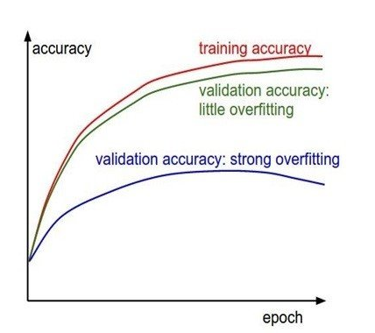
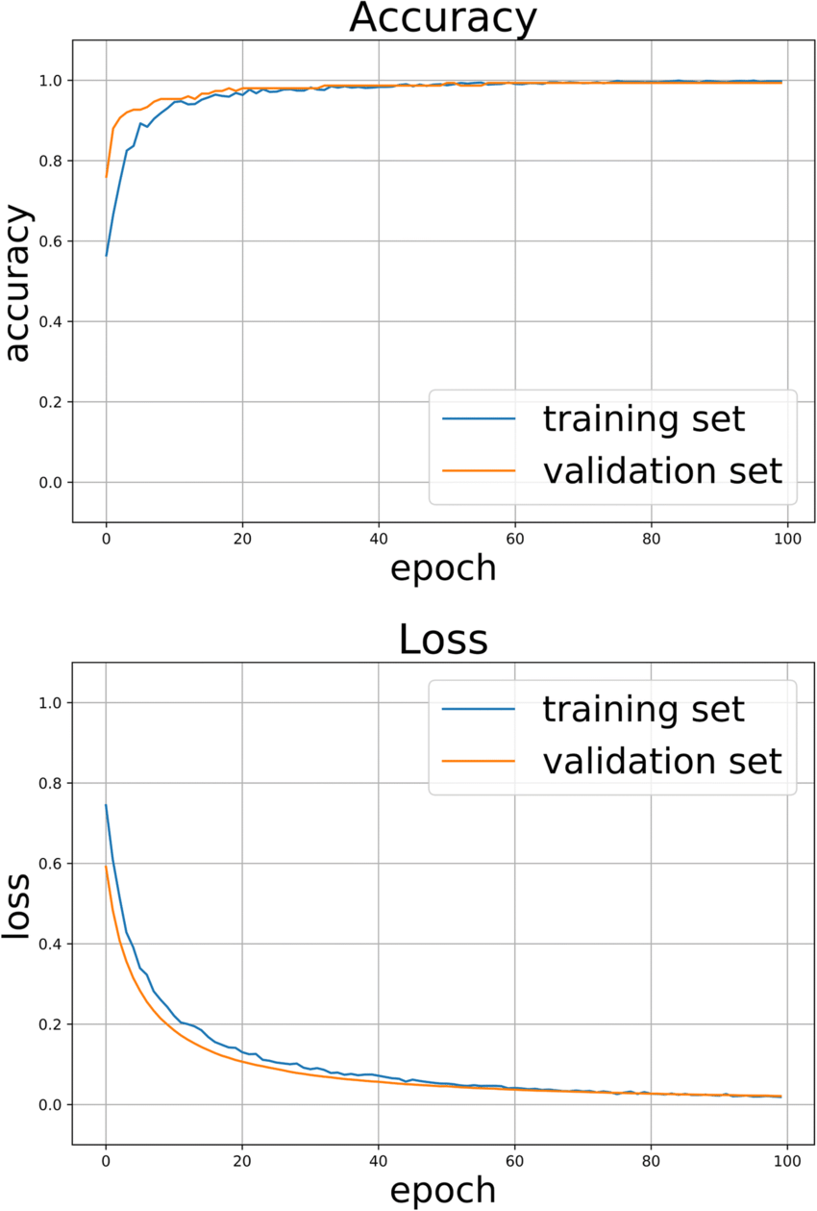
Interpreting Deep Learning Models
Accuracy and Loss Plots
Small Difference between the training and validation Curve
Little Degree of Overfitting
Large Difference between the training and validation Curve
Strong Degree of Overfitting
https://tinyurl.com/34uj6vsd
https://tinyurl.com/y5cst8wa

Slide 4
Overview
Lab4: Deep Learning
Objective 1
Objectives 2, 3, 4
Objectives 5 & 6
Objective 7
Upload Jupyter Notebook on Google Colab
Train Deep Learning Models
Deploy model onto edge device
Homework
Download Jupyter Notebook from Brightspace
Import libraries and datasets
Install the correct libraries and dependencies
Repeat training the two models using different dataset
Locate it on the edge device
Create the Neural Network Architecture
Confirm correct installation
Load the dataset
Login to Google Colab using your Google Credentials
Compile the model and define parameters
Download the trained model from Colab
Refer to objectives 2, 3, and 4 for training
Upload the Notebook
Train the model
Load the model on the edge device

